Slide 1
Evolution of Artificial Neural Network Architecture
Student: Matija Bačić, 0036507836
Mentor: doc. dr. sc. Marko Čupić
Bachelor thesis DEFENSE
FAKULTET ELEKTROTEHNIKE I RAČUNARSTVA, SVEUČILIŠTE U ZAGREBU
2019./2020.

Slide 2
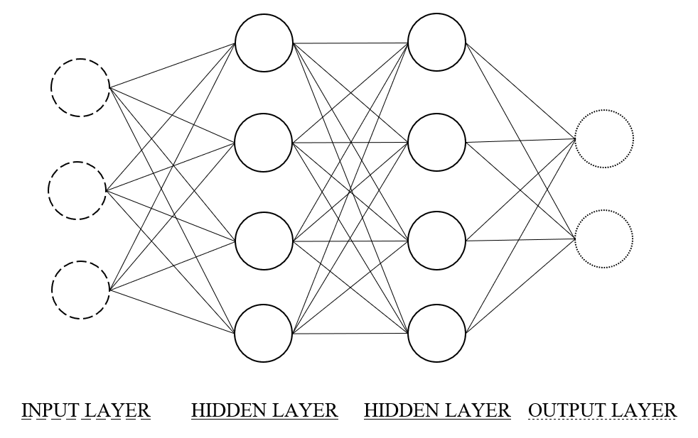
Artificial neural network

Slide 3
Training an artificial neural network
Input-output mappings
Supervised learning : backward propagation
Unsupervised learning : k-means
Reinforcement learning : evolution

Slide 4
Evolutionary algorithms
Generate an initial population of size N
Calculate fitness of every individual in the population (evaluation)
If stop condition is satisfied, terminate the process
Create a new population
Select two individuals from a population
Create an offspring through a crossover operation
Mutate the offspring and add it to the new population
Repeat step 4 while size of the new population is less than N
Go to step 2 with population = new population (advance into next generation)

Slide 5
NeuroEvolution of Augmenting Topologies (NEAT)
How to encode neural networks to allow crossover of different topologies?
How to protect topological innovation that needs few generations to be optimized so that it does not disappear from population too early?
How to minimize network topology though evolution?
Key ideas: genetical encoding, historical markings, speciation

Slide 6
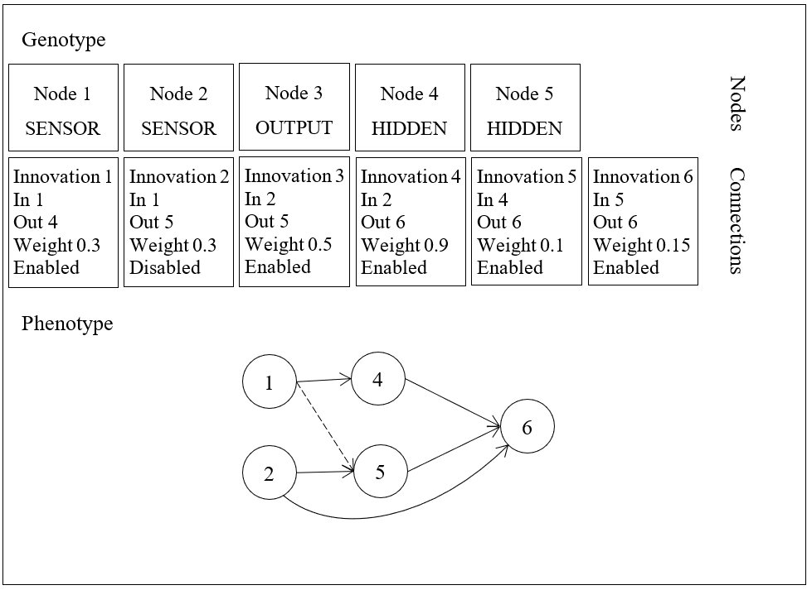
Genome
Genome – sequence of network connections and nodes

Slide 7
Mutations
Mutations:
Weight mutations
Random
Small perturbation
Add connection mutation
Add node mutation

Slide 8
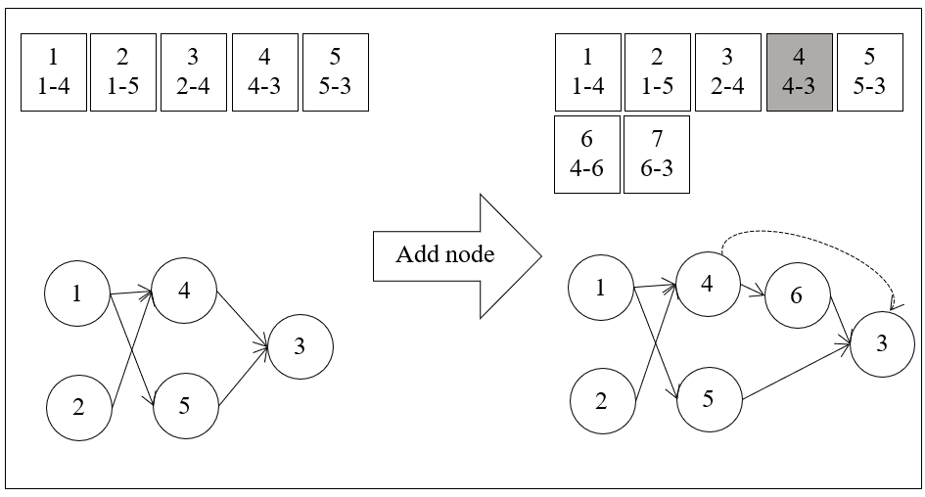
NEAT
Add node mutation

Slide 9
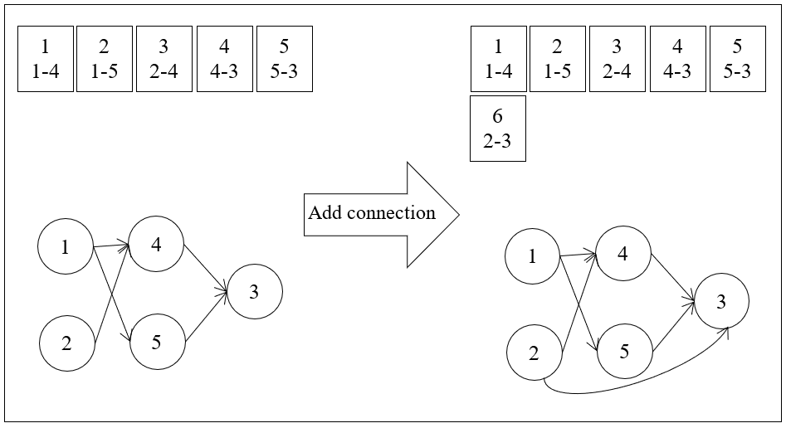
NEAT
Add connection mutation

Slide 10
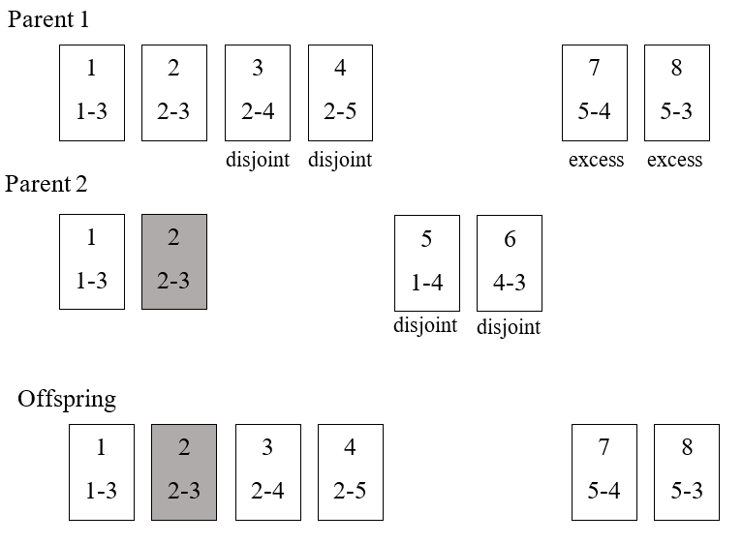
Crossover
Crossover operator

Slide 11
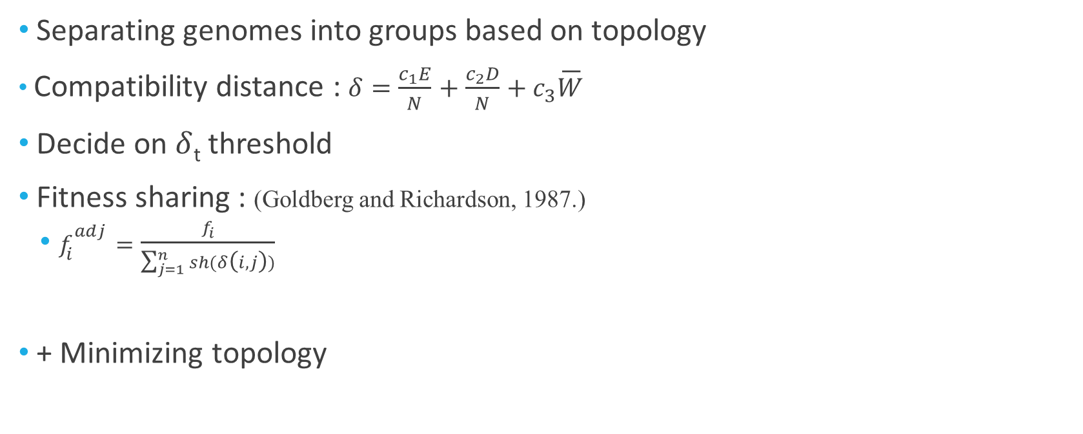
Speciation
Separating genomes into groups based on topology
Compatibility distance : $δ=\frac{c_{1}E}{N}+\frac{c_{2}D}{N}+c_{3}\overline{W}$
Decide on $δ$_{t} threshold
Fitness sharing : (Goldberg and Richardson, 1987.)
$f_{i}^{adj}=\frac{f_{i}}{\sum_{j=1}^{n}{sh(δ\left(i,j\right))}}$
+ Minimizing topology

Slide 12
Example 1 : XOR problem
Parameter | Value
Number of input nodes | 2
Number of output nodes | 1
Population size | 100
Weight mutation probability | 60%
Weight perturbation probability | 90%
Add node mutation probability | 2.5%
Add connection mutation probability | 2.5%
c₁ | 1
c₂ | 1
c₃ | 0.4
δ_{t} (compatibility distance threshold) | 3
Minimum number of genomes in species survival | 5
Percentage of population copied with only mutation | 50%

Slide 13
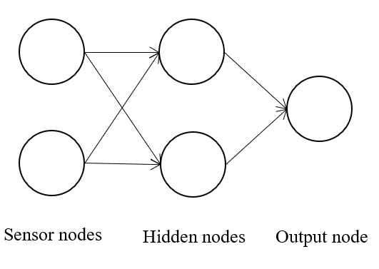
Example 1 : XOR problem
Number of iterations : 100
Fail rate : 0%
Found optimal solution in 18% of iterations
Minimal number of nodes : 5, maximum number of nodes : 14, average : 7.5, std. dev.: 2.4
Minimal number of generations : 15, maximum : 95, average : 43.2

Slide 14
Example 1 : Single agent system (Unity)
Flappy bird like game
Single agent : bird
Pressing space bar makes bird jump (flap) in mid air
Touch ground or pipes => game over

Slide 15
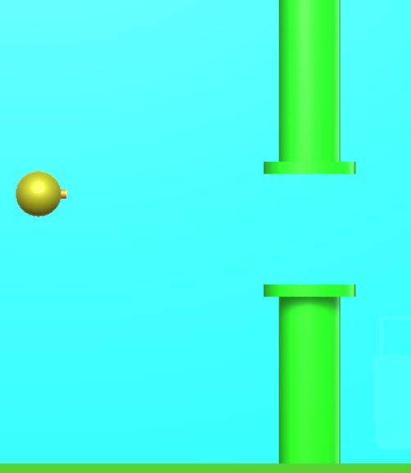
dt
d
db

Slide 16
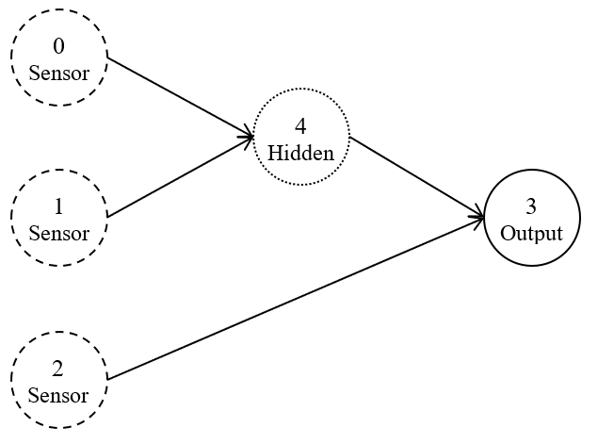
Example 1 : Single agent system (Unity)
Solution -> score at least 50
100 runs
Solution found in avg. of 7.4 generations
Std.dev. : 2.3

Slide 17
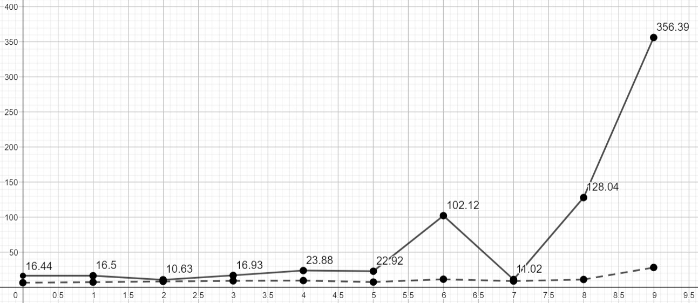
Example 1 : Single agent system (Unity)
Maximum (filled line) and average (dashed line) fitness per generation

